Slide 1
COVID-19 Case Surveillance Public Use Data
Jeffrey, Nathan, Nathanael

Slide 2

Introduction
COVID-19:
Is an infectious disease started back in December 12, 2019
The CDC has a database that stores all covid-19 cases. (US)
Data:
Clean and Visualize data by different distributions and predict the outcome by different data algorithms.
Algorithms:
Using Naive Bayes, K-Means, kNN and Spectral Clustering

Slide 3
Purpose
Quantitatively compare and contrast spectral clustering with K-means and KNN clustering in order to determine the relationship between peaks of Covid-19 transmission and likelihood of death.
Predict the likelihood of death given multiple factors about a patient.

Slide 4
Techniques & Tools
Naive Bayes
K-Means
Spectral Clustering
KNN
Predicting the likelihood of death given the factors of Covid-19.
Used to apply data with categorical predictors and compare probability or the likelihood of an event
Analyzes unlabeled samples and attempts to place in related clusters. The variable k represents the number of clusters imposed on the data.
• Used to identify k records in the training dataset that are similar to
the new record we intend to classify.
• Uses the similar records to classify the new record associated to its
nearest neighbors.
• does not make assumptions about the relationship between the class membership and the predictors.
Divides the data points into several groups such that points in the same group are similar and points in different groups are dissimilar to each other.

Slide 5
Expected Outcome
We predict that during peak transmission points of Covid-19 that there will be more deaths.
We predict that elderly people will be more susceptible to dying from Covid than other age groups
We will also be looking at gender and race to determine if a specific demographic is more susceptible to dying from Covid

Slide 6
Project’s Outcome
01
03
02
04
Data
Use of Data Models
Cleaning & Visualization
Results

Slide 7
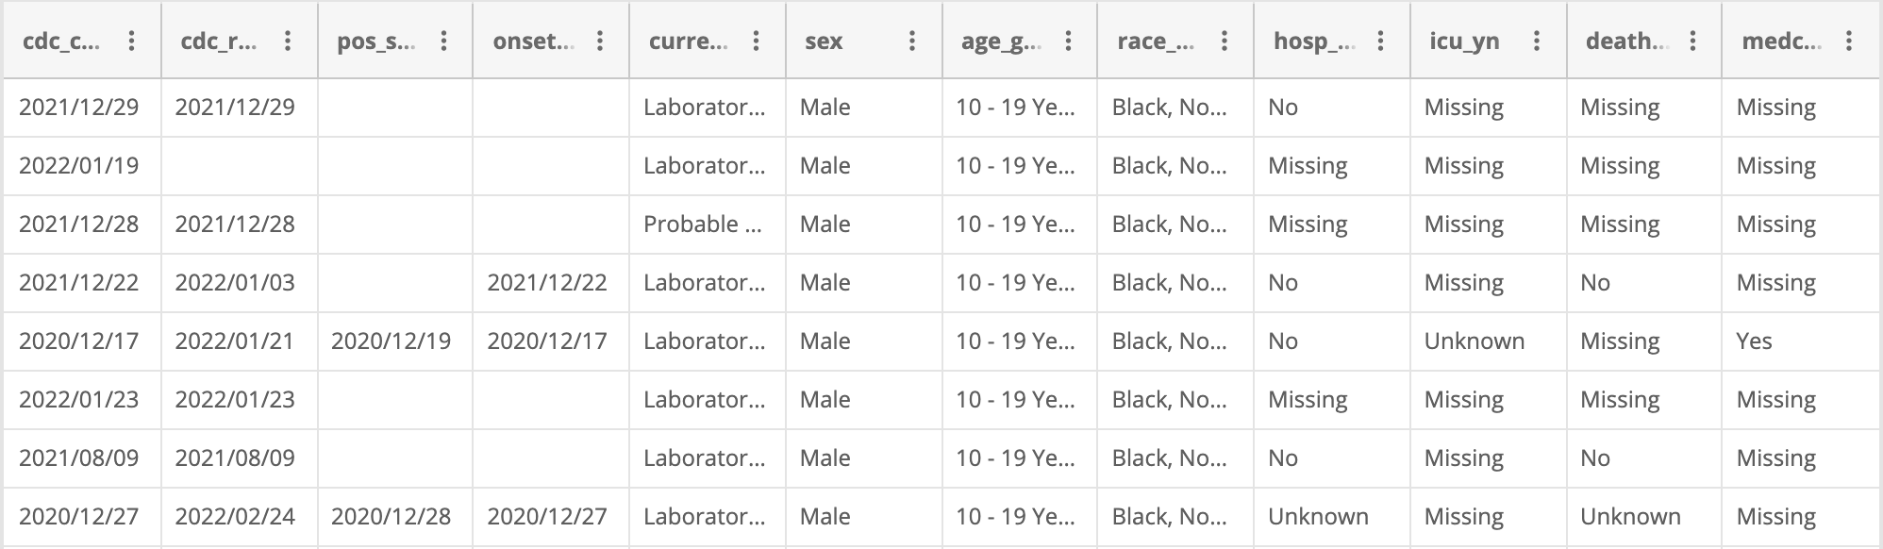
Data

Slide 8
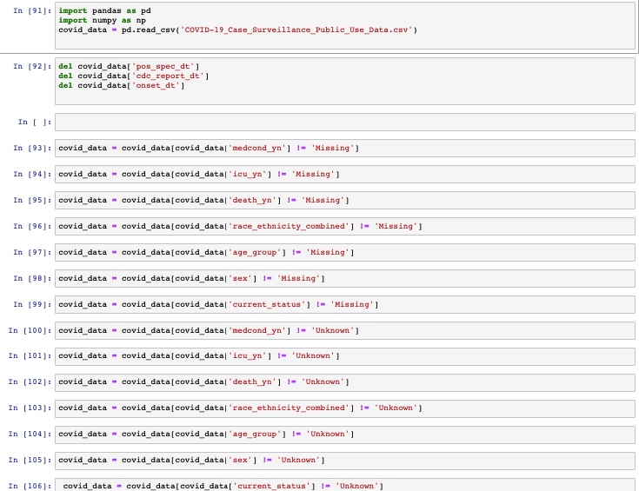
Cleaning Code

Slide 9
PROCESS: Cleaning Data
Step 1
Step 2
Step 3
Step 4
Step 5
Result
Download Covid-19 Case Surveillance Public Use Data csv file
Deleted first positive specimen date, CDC report date, and onset of symptoms date columns.
Deleted all rows that were missing elements
Deleted all rows that were unknown elements
Save new data set to new csv file
Cleaned 69,664,983 rows to 1,094,551 rows

Slide 10
[]
Visualizations

Slide 11
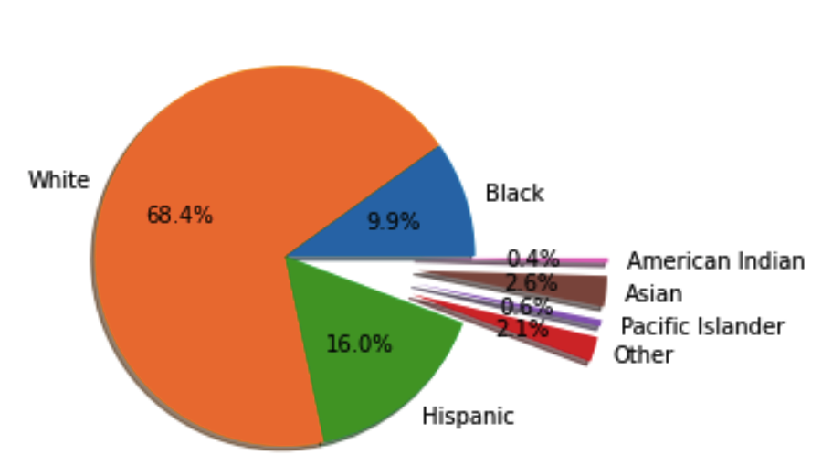
Distribution of People

Slide 12
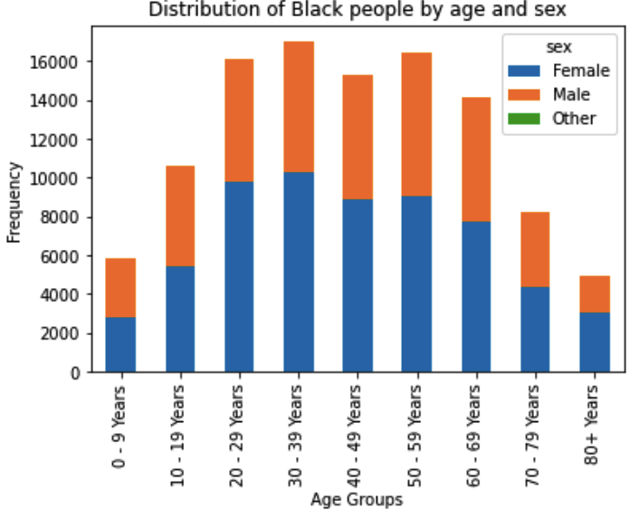
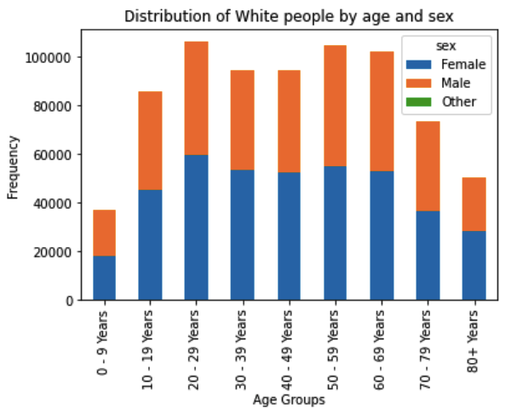
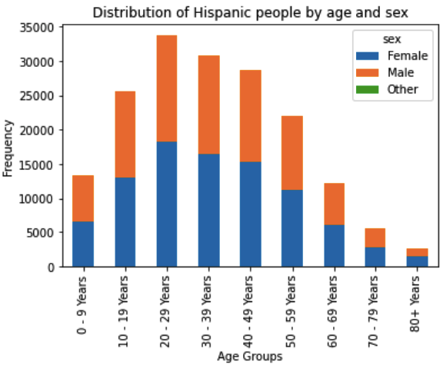
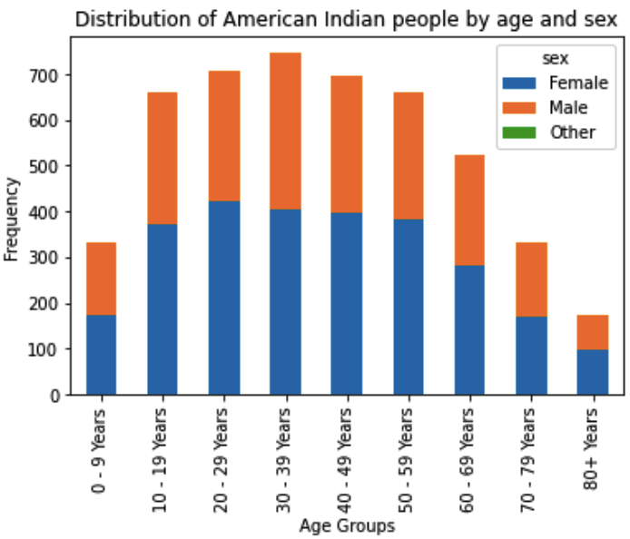
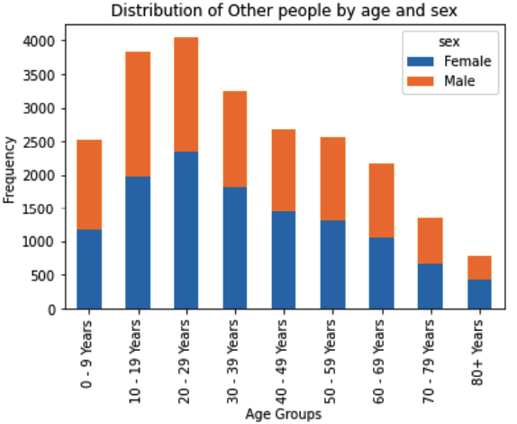
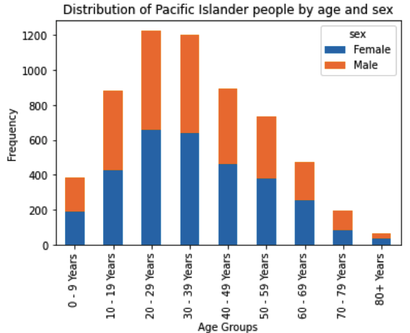
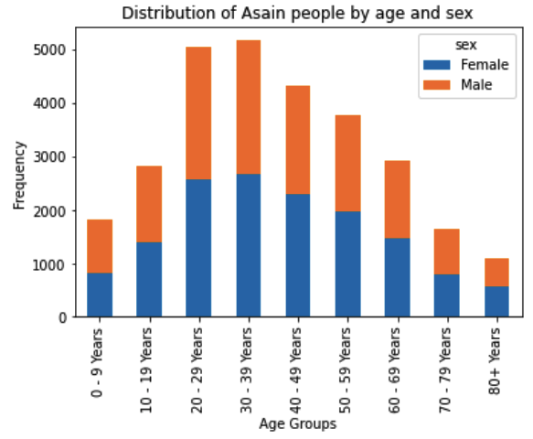
Visualizations of different Races
Notes:
Different Races: Black, White, Hispanic, Other, Pacific Islander, American Indian and Asain.

Slide 13
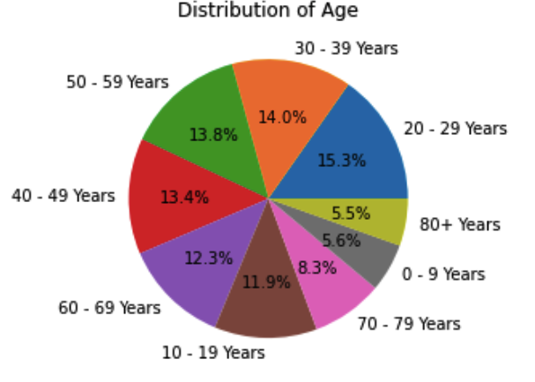
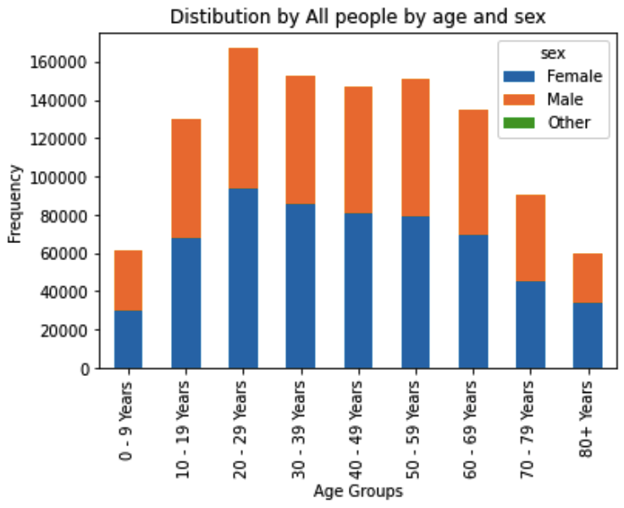
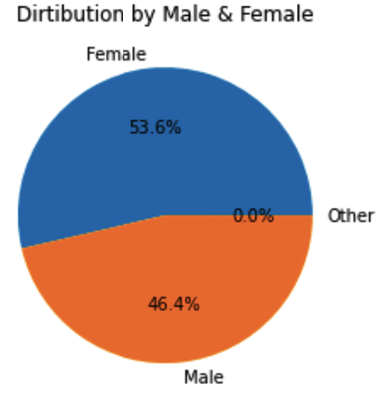
Visualizations of All

Slide 14
(‘’)
Methods

Slide 15
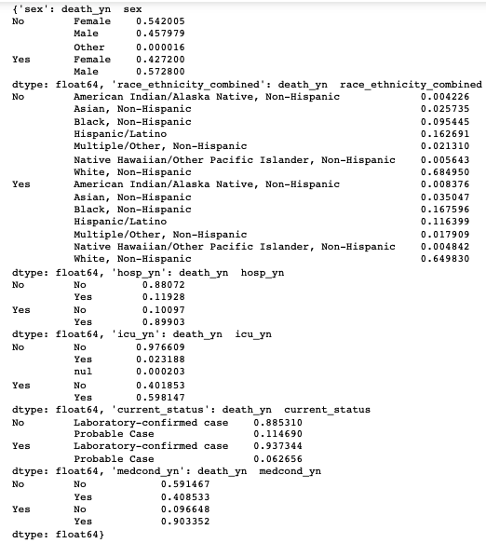
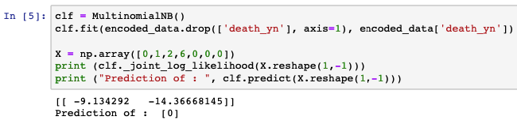
Naive-Bayes
First we calculated the percentages that ended in death, then we calculated a likelihood table to determine the individual percentage of death based on specific feature. Lastly, we used a naive-bayes model to create an angorthim that would predict the possibility of death based on the input of these specific features such as; lab confirmed case, sex, age, race, hospitalization, ICU, and underlying conditions.

Slide 16
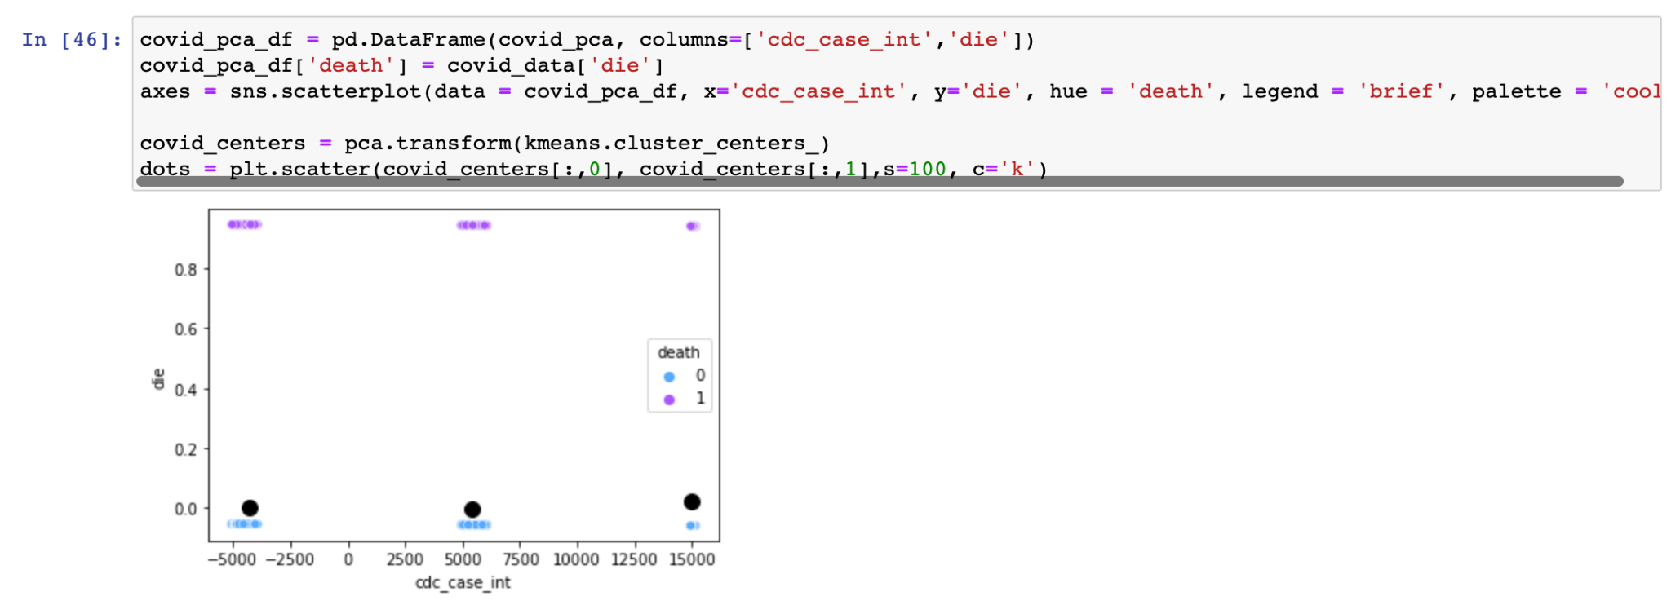
K-Means
First we took the earliest report column and changed it from dates to ints, then we used sklearn’s k-means model and Principle Component Analysis (PCA) estimator to help us plot the centroid locations. The columns that we plotted were the earliest report column and death column.

Slide 17
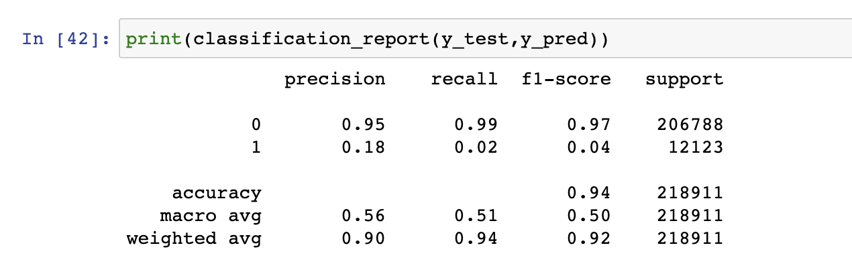
k-Nearest Neighbors
First we took the earliest report column and changed it from dates to ints, and changed the deaths column to a binary value (0,1), then we selected the training set and testing set, then we did preprocessing using sklearn’s standardscaler. Then we used the sklearn’s k-neighbors classifier to test the predicted data. Lastly. to determine the results of the tests we made a confusion matrix and called classification_report.

Slide 18
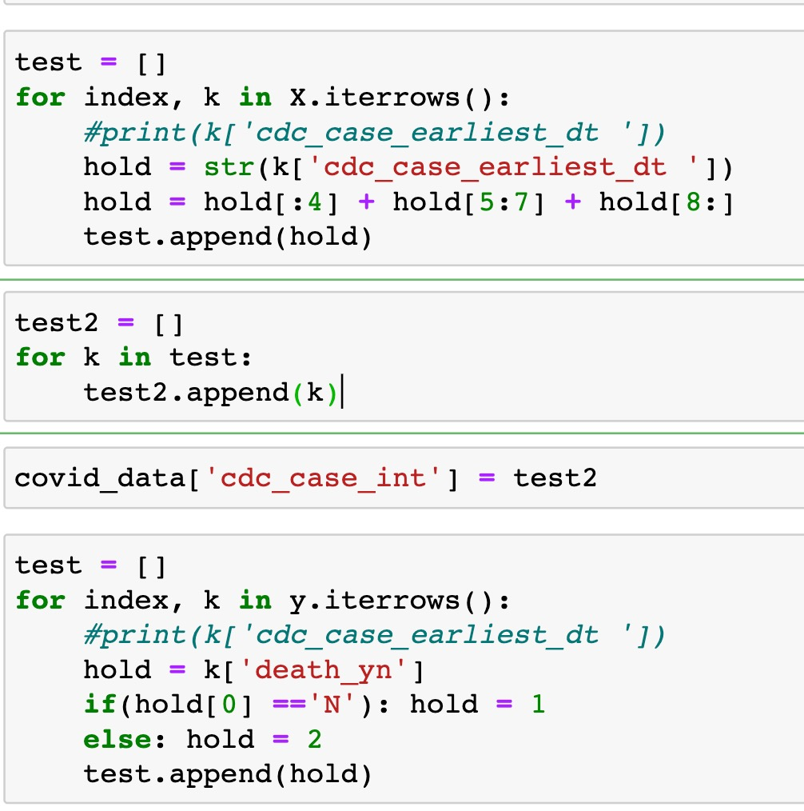
Spectral Clustering
First we took the earliest report column and changed it from dates to ints, and changed the deaths column to a binary value (0,1), then we imported numpy in order to change our dataframe into more friendly arrays. With these arrays we used sklearning spectral clustering to fit our data. Unfortunately our dataset was too large to work with the spectral clustering model, and even with a minimal amount of clusters the jupyter notebook would not complete and die.

Slide 19
{}
Analysis / Conclusion

Slide 20
Analyzation of Data
Naive-Bayes
K-Means
kNN
Spectral
Clustering
The Naive-Bayes model provided us with an accurate algorithm to predict likelihood of death based on select features. According to our demographic, there is a high probability that we would not die.
The K-Means model showed an accurate distribution of peak covid transmission time periods. While deaths increased in peak periods, the proportionality of deaths to not deaths stay consistent regardless of peak times.
Given the date of someone contracting covid, there is a low probability that death can be predicted. On the other hand, the kNN model had a high accuracy of predicting non-deaths.
Unfortunately, our dataset was too large to accommodate spectral clustering given the constraints of our environments.

Slide 21
Model Comparison
Both the Naive-Bayes and kNN models struggled to classify instances where death occurred. However they were both highly accurate in predicting instances of non-deaths. The Naive-Bayes did allow for more specification then the kNN model.
The K-means model worked well to cluster our data into three clustoids, but still struggled to classify deaths similarly to the kNN model.
Project Specification- 70:30

Slide 22
Reference
[1] https://data.cdc.gov/Case-Surveillance/COVID-19-Case-Surveillance-Public-Use-Data/vbim-akqf

Slide 23
Thanks for listening.
Any Questions?

